Slide 1
Black Pear Software
An Agile Approach to Integrated Shared Care across Health & Social Care

Slide 2
Who We Are
The Team
25 Years Experience in clinical systems and health informatics
Clinically Led with focus on the use case not the technology
Work to National Standards and national guidelines
The Credentials
Founder Member of INTERopen
CTO is chair of HL7 UK
Committed to opensource and open standards
Focus Of Activity
25%
Bespoke
and
3rd Party
75%
NHS Solutions
eRA and eSP

Slide 3
Modular Technology Components – Our ‘Lego Kit’
pyrusCloud
Cloud based EPR - FHIR Enabled
Caching and synchronisation service for existing systems.
Sophisticated messaging engine for alerts and workflow notifications
pyrusKit
Form Design environment
Manages FHIR resources to data entry fields
Drag and drop build and shared asset library
pyrusium
A container for web apps
Unique interface to GP and other systems
Enables context aware ‘read and write’ with clinical systems
pyrusApps
Dynamic RAD framework for delivering web based healthcare apps and forms
SNOMED, Read , CTV3, ICD-10 & FHIR enabled
Intelligent guided controlled workflows
pyrusConnect
Proprietary integration framework allowing disparate systems to communicate
Based on HL7 FHIR standards
‘on the fly’ contextual access to ‘read and write’ with GP clinical; systems and hospital integration engines
Warden
Command & control
Project & Organization Service configuration
Project & Organization User configuration ‘Selfish-views’
‘Pyrus’ - Latin for Pear

Slide 4
The Somerset Integrated Digital Electronic Record – SIDeR

Slide 5
A Recipe For SIDeR
Core Requirements
Technical audit and FHIR Consultancy
Real time creation and presentation of patient information from outside of each health and social care provider
Read Write Access to EMIS Web Primary care records as structured data to other health and social care providers
Improving End of Life Care system and processes Connecting Out of Hours, Secondary Care & Community teams
Deliver person/patient use cases for Information Sharing (home first, ADT alerts, Encounters, etc)
Enable NHS Number as the primary key for Information Sharing across health and social care
Care Home CQUIN Management – County wide bed status
Enable all care providers to publish & share care documentation (care plans, risk assessments)
Secure Messaging between providers and Task Alerts into core clinical and case management systems
Notes:
Technology Partner not supplier - general aim for Somerset to become self-sufficient
Use Case driven requirements

Slide 6
A Recipe For SIDeR
How it will Work - Integrations
Spine
SMSP
GP’s &
Extended
Hours
Secondary
Care
Out Of Hours
Ambulance
SWAS
NHS 111
Community
Pharmacy
Social Care

Slide 7
A Recipe For SIDeR
How it will Work – Access and Messaging
Spine
SMSP
GP’s &
Extended
Hours
Secondary
Care
Out Of Hours
Ambulance
SWAS
NHS 111
Community
Pharmacy
Social Care
ADT Notifications
Encounters
Observations
FHIR Resources which can be updated from connected source systems when a care plan is accessed by a user.
Medications
Diagnosis / Procedures

Slide 8
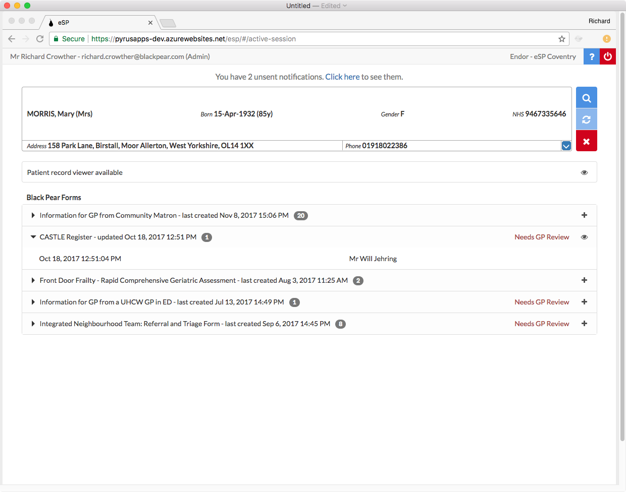
SIDeR Patient View
Primary Care record view available
Social Services record view available
Community Care record view available
Secondary Care record view available
SIDeR Shared Care Forms
1
End of Life Care Plan – updated Oct 18, 2017 12:51 PM
Patient Assessments From Other Providers
Bed Rail Assessment – updated Oct 18, 2017 12:51 PM

Slide 9
Questions ?
Integrating Services
Connecting Providers

